Slide 1
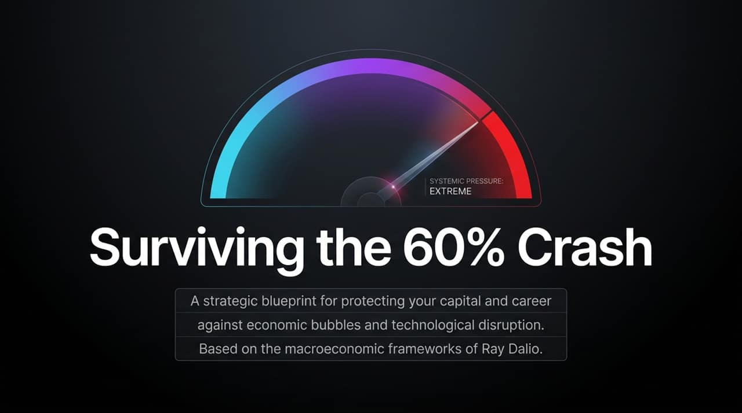
Notes:
https://www.youtube.com/watch?v=0WMfXrEf03c
Introduction: Welcome everyone. Today, we are discussing actionable strategies to safeguard your capital and protect your career during times of severe macroeconomic volatility and rapid technological acceleration.
Core Premise: Ray Dalio highlights two intersecting systemic pressures unfolding right now: first, a major financial bubble driven by debt dynamics and potential market crashes; and second, an unprecedented shift in labor market economics caused by Artificial Intelligence.
Dual Action: To navigate this environment safely, you cannot rely solely on protecting your portfolio or solely on keeping your job. Survival requires a integrated, two-pronged strategy: building a Financial Shield for your capital and leveraging a Human Sword for your career.

Slide 2
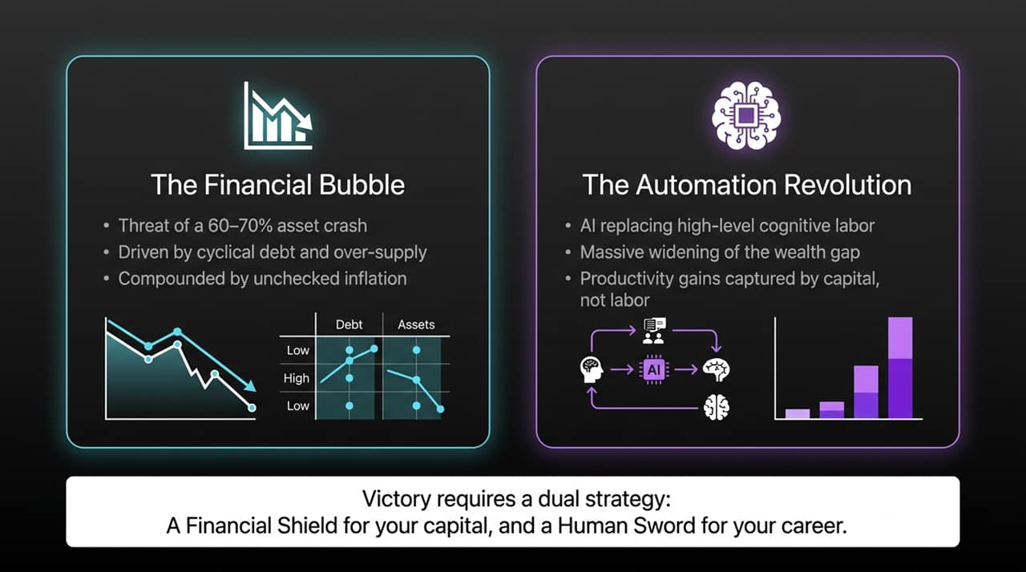
Notes:
Financial Threat: As Ray Dalio notes, asset markets regularly undergo cyclical boom-and-bust dynamics. When severe market downturns occur, major equity indexes can drop between 60% to 70%. This isn't just theory; it is the recurring nature of debt-driven market cycles.
Automation Threat: Simultaneously, we are witnessing AI transition from basic automation to replacing high-level cognitive labor, white-collar analysis, and reasoning tasks.
Macro Dynamic: In previous technological shifts, labor captured a substantial portion of economic growth. Today, productivity gains are increasingly flowing directly to capital owners and AI infrastructure holders rather than workers.

Slide 3
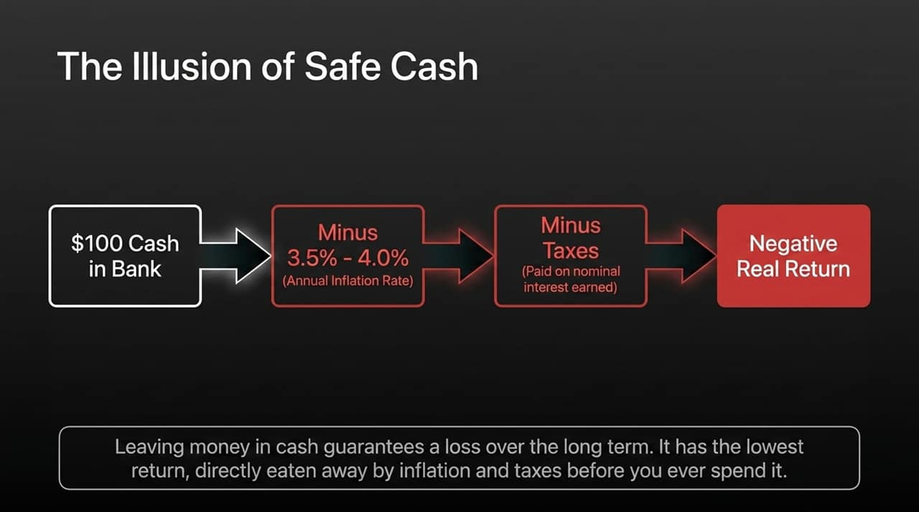
Notes:
Psychological Trap: During market instability, the default reaction for many investors and average individuals is to retreat to cash or short-term deposits because it "feels safe".
The Math of Cash Depreciation: Dalio explicitly addresses this misconception: cash is almost guaranteed to be the worst long-term investment asset class.
Mechanism: If inflation runs at 3.5% to 4.0% per year, holding uninvested cash guarantees an immediate drop in real purchasing power. Even if high-yield cash accounts match that inflation rate with nominal interest, you are still taxed on that interest income. Once taxes are deducted from nominal interest, your net real return on cash becomes negative.
Takeaway: Cash is not a safe haven for wealth preservation over time; it is a guaranteed leak in purchasing power.

Slide 4
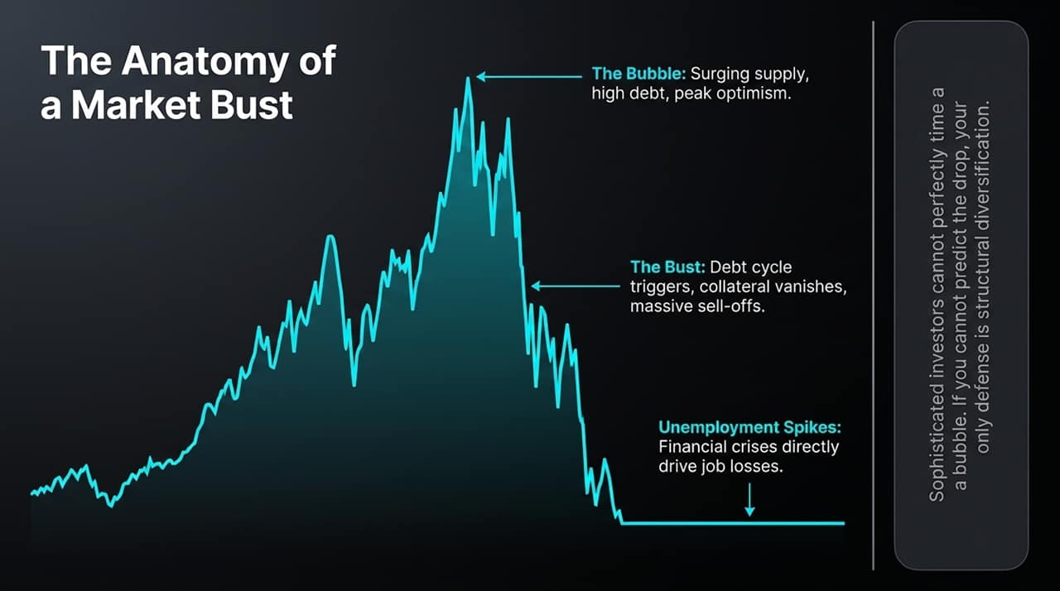
Notes:
The Bubble Cycle: Bubbles are fueled by surging asset supply, rising leverage, and peak optimism. Eventually, debt-servicing limits are breached, collateral values fall, and panic leads to forced liquidations.
Timing Delusion: Dalio points out that even the most sophisticated, professional institutional investors struggle or fail to time bubbles accurately. Attempting to buy at the exact bottom or sell at the exact top is a losing battle.
Economic Spillover: When financial asset values collapse by 60–70%, collateral vanishes, credit contracts, and consumer/corporate spending halts. This economic contraction directly triggers widespread unemployment spikes.
Strategic Shift: Because timing the bust is impossible, structural diversification is your only viable line of defense.

Slide 5
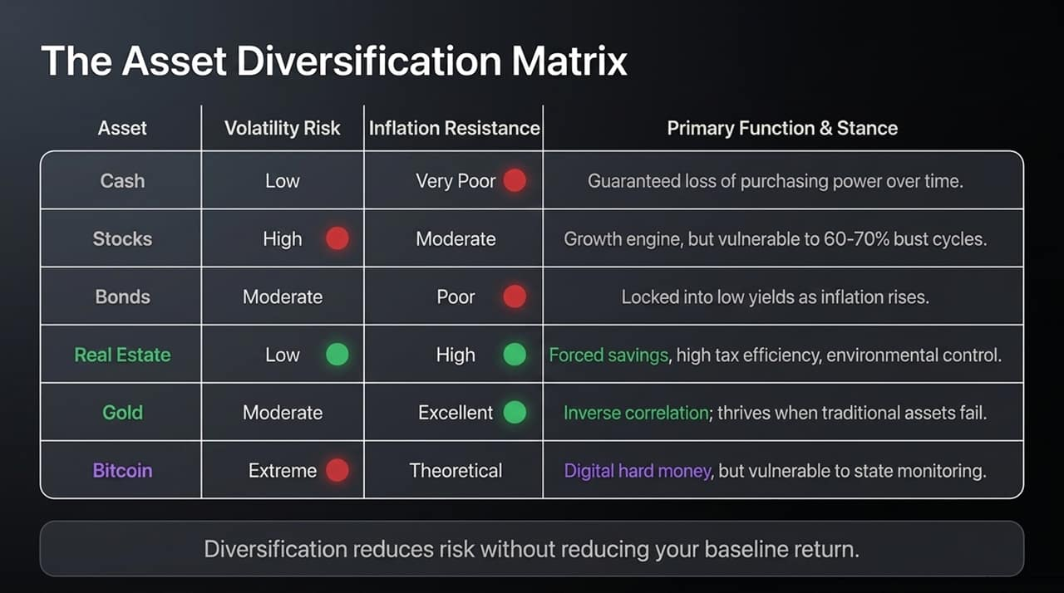
Notes:
Principle: True diversification does not mean holding ten different stocks; it means holding assets that respond differently to changing economic environments. Proper diversification dramatically reduces risk without sacrificing baseline returns.
Asset Analysis:
Stocks: Strong long-term growth engine, but highly vulnerable to 60–70% drawdown cycles.
Bonds: Risk losing value when inflation and interest rates rise, locking in low yields.
Real Estate: Serves as a forced-savings vehicle, offers tax advantages, and provides control over your immediate physical environment.
Gold: Historically inverse-correlated with traditional paper assets; performs strongly when trust in fiat currency or financial systems declines.
Bitcoin: Digital scarcity asset, though highly volatile and subject to unique regulatory and technological risks.

Slide 6
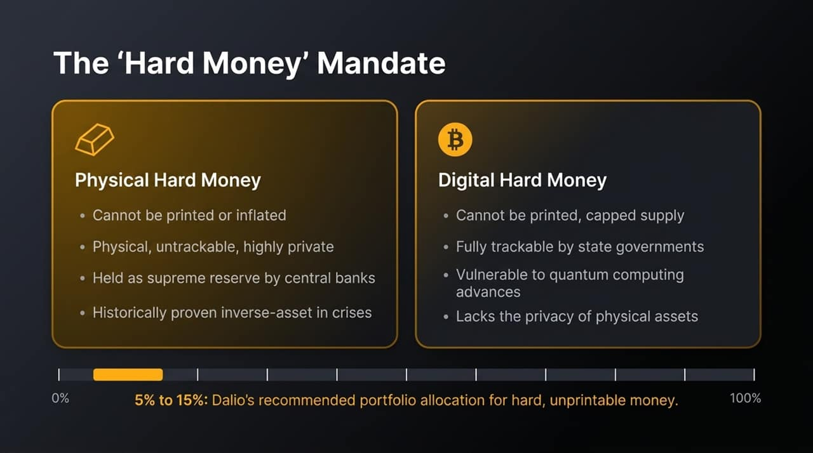
Notes:
Defining Hard Money: Hard money consists of assets that cannot be printed or inflated at will by central bank policy. Dalio recommends maintaining an allocation of 5% to 15% of your portfolio in hard money.
Physical Hard Money (Gold): Gold remains the primary reserve asset after fiat. It carries zero counterparty liability—meaning its value isn't dependent on someone else's promise to pay. It cannot be hacked by quantum computing and offers physical privacy during geopolitical crises.
Digital Hard Money (Bitcoin): Bitcoin shares the attribute of unprintable, capped supply. However, Dalio cautions that digital assets are traceable on public ledgers, subject to potential state regulation/prohibition, and face future technological risks like quantum decryption. Central banks hold gold reserves, not Bitcoin, for these security and control reasons.

Slide 7
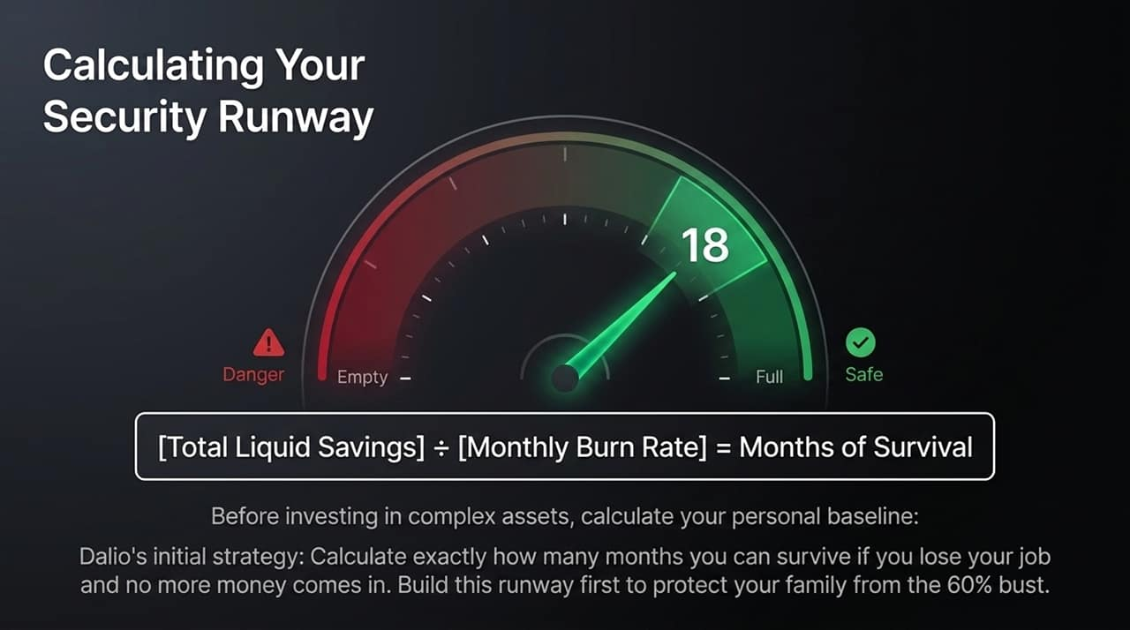
Notes:
First Step in Wealth Management: Before worrying about complex asset allocation, you must establish a personal security baseline.
The Runway Calculation: Take your Total Liquid Savings and divide it by your Monthly Burn Rate (total essential expenses per month). The result is your absolute runway in months.
Dalio's Personal Foundation: Dalio shares that early in his career, before managing large pools of capital, his top priority was calculating exact survival time. He built up savings to cover months—and eventually years—of zero income so his family would remain secure regardless of market shocks or job loss.

Slide 8
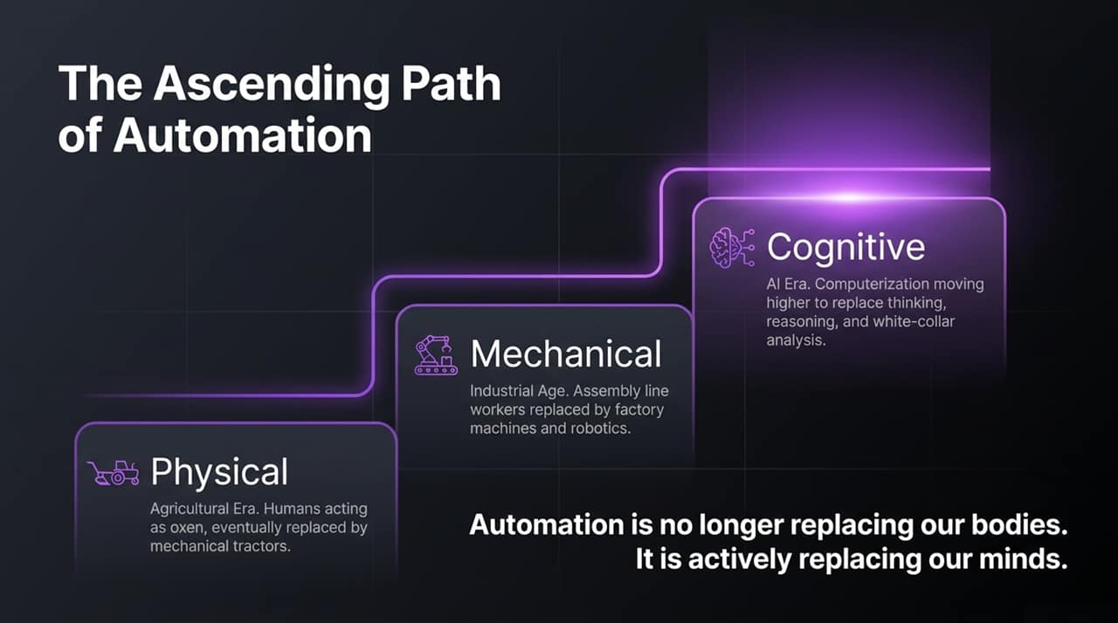
Notes:
Historical Trajectory: Human displacement by technology has evolved in distinct waves:
Physical Era: Agricultural tools and tractors replaced human physical labor in fields.
Mechanical Era: Industrial machinery and assembly lines replaced manual dexterity in factories.
Cognitive Era: AI and high-level compute are moving up the cognitive chain to displace complex reasoning, white-collar analysis, and knowledge work.
Core Realization: Automation is no longer just extending or substituting physical muscles; it is actively replicating human intellect and decision-making.

Slide 9
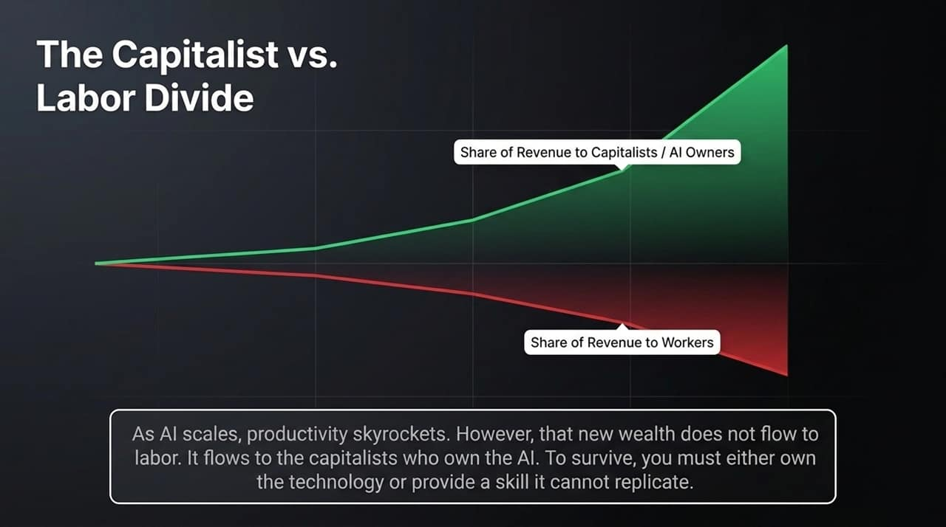
Notes:
Revenue Split Dynamics: In a standard economy, company revenue is split between labor costs (wages) and capital owners (profits/equity holders).
AI Disruption: As AI replaces white-collar tasks, corporate productivity increases while labor expense drops. Consequently, the percentage of overall corporate revenue going to workers shrinks, while the share going to technology/capital owners expands significantly.
Career Implication: Relying solely on selling basic hourly labor leaves you on the wrong side of this economic trend. To survive, you must either own equity/capital or possess cutting-edge skills that machines cannot yet replicate.

Slide 10
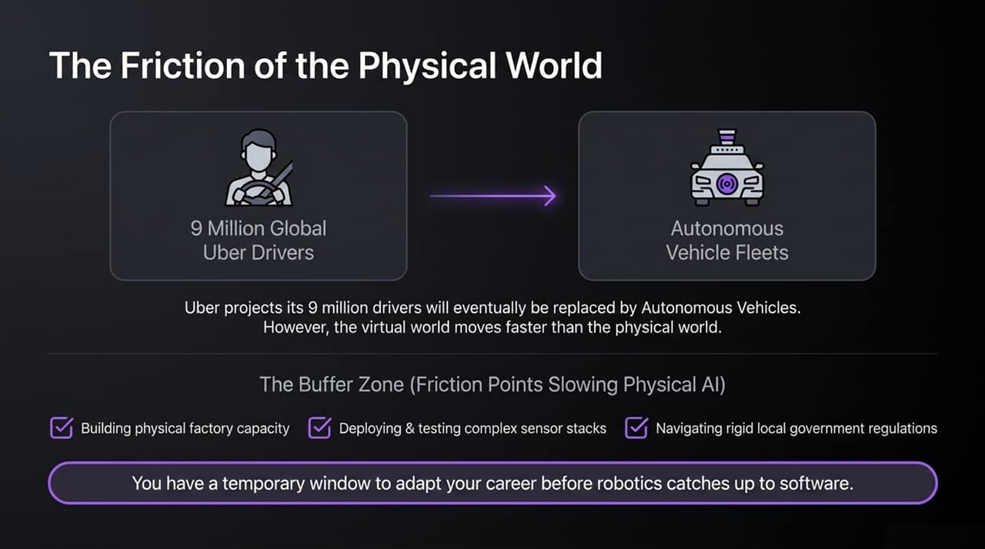
Notes:
Virtual vs. Physical AI: Software-based AI spreads rapidly across digital networks. However, physical AI (robotics, autonomous fleets) faces real-world friction points that slow down its deployment.
Case Study: Platforms like Uber anticipate that millions of human drivers could eventually be replaced by autonomous vehicle fleets.
The Buffer Window: Physical deployment requires scaling manufacturing capacity, perfecting complex sensor stacks, navigating legal liability, and gaining municipal regulatory approvals. This physical friction creates a vital grace period for individuals to adapt their skill set before full-scale physical automation takes hold.

Slide 11
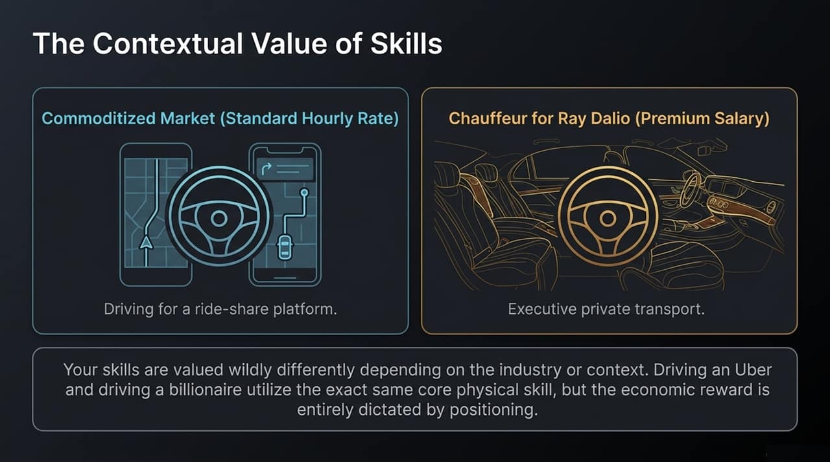
Notes:
Skill vs. Environment: The economic market value of a skill depends heavily on the context and industry in which it is deployed.
Comparison: Driving a vehicle for a standard ride-sharing service yields low, commoditized hourly earnings. However, driving as a private executive chauffeur for a high-net-worth individual utilizes the exact same baseline physical skill set, yet yields a far higher salary due to client context, trust, and positioning.
Strategic Pivot: Instead of trying to work 20% harder in a commoditized, low-leverage industry, pivot your existing skills into high-leverage, premium contexts.

Slide 12
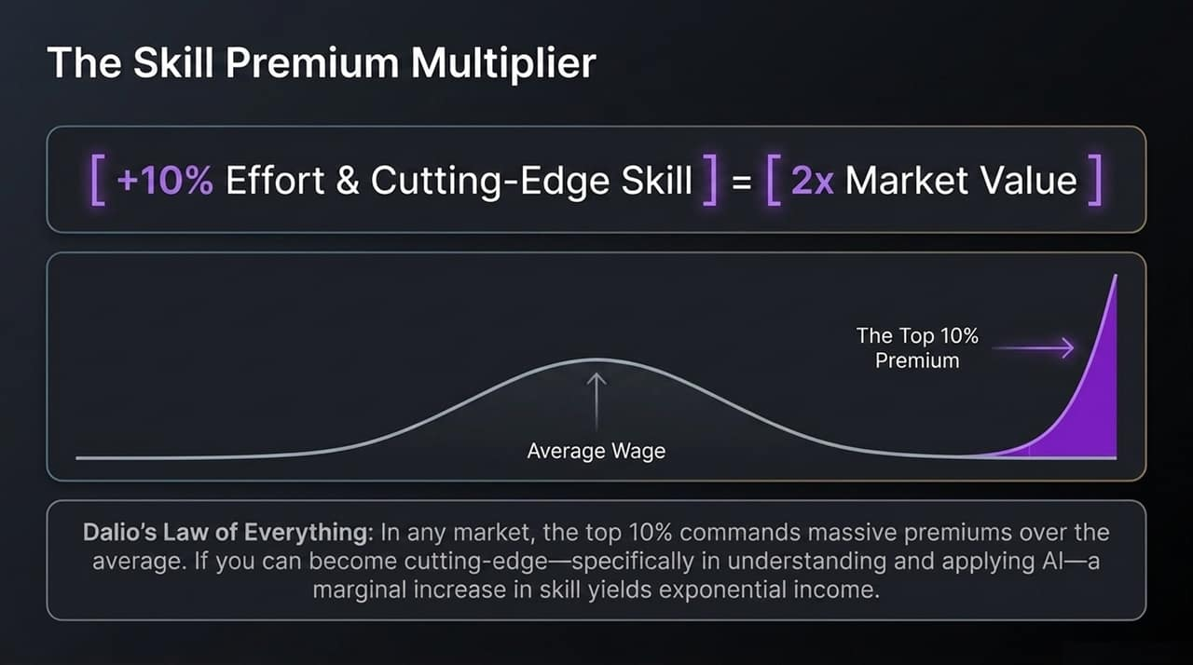
Notes:
Law of Multiples: In almost every market—whether fine art, real estate, or professional labor—the top tier commands disproportionately high financial rewards relative to the average.
The Power Curve: Moving from average to the top 10% in skill or execution does not deliver a linear 10% raise; it delivers exponential multiples in income.
AI Mastery: Today, achieving top 10% status requires integrating cutting-edge AI tools into your daily workflow. Investing a modest amount of focused effort into AI fluency dramatically increases your output and market valuation.

Slide 13
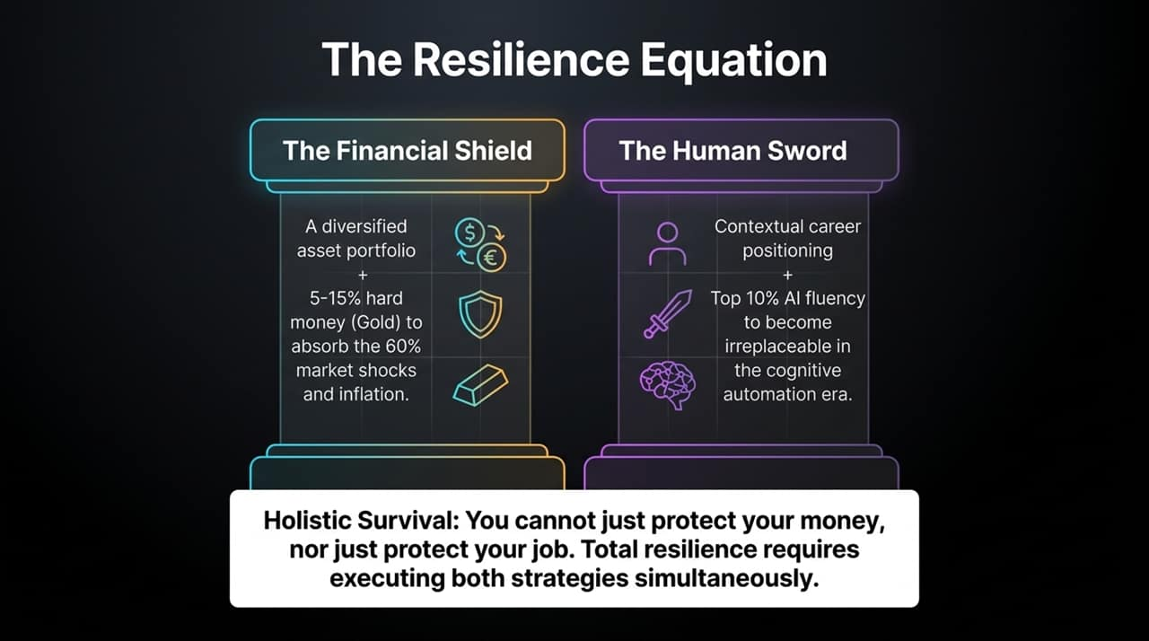
Notes:
Synthesis: Complete personal resilience requires uniting financial tactics with career strategy.
Financial Shield: A structurally diversified asset portfolio anchored by a 5–15% allocation in hard money (such as gold) to absorb market drawdowns and persistent inflation.
Human Sword: Strategic career positioning paired with top 10% AI fluency to maintain high-value leverage in an automated workforce.
Action: Implementing only one leaves you exposed; executing both ensures total financial and professional security.

Slide 14
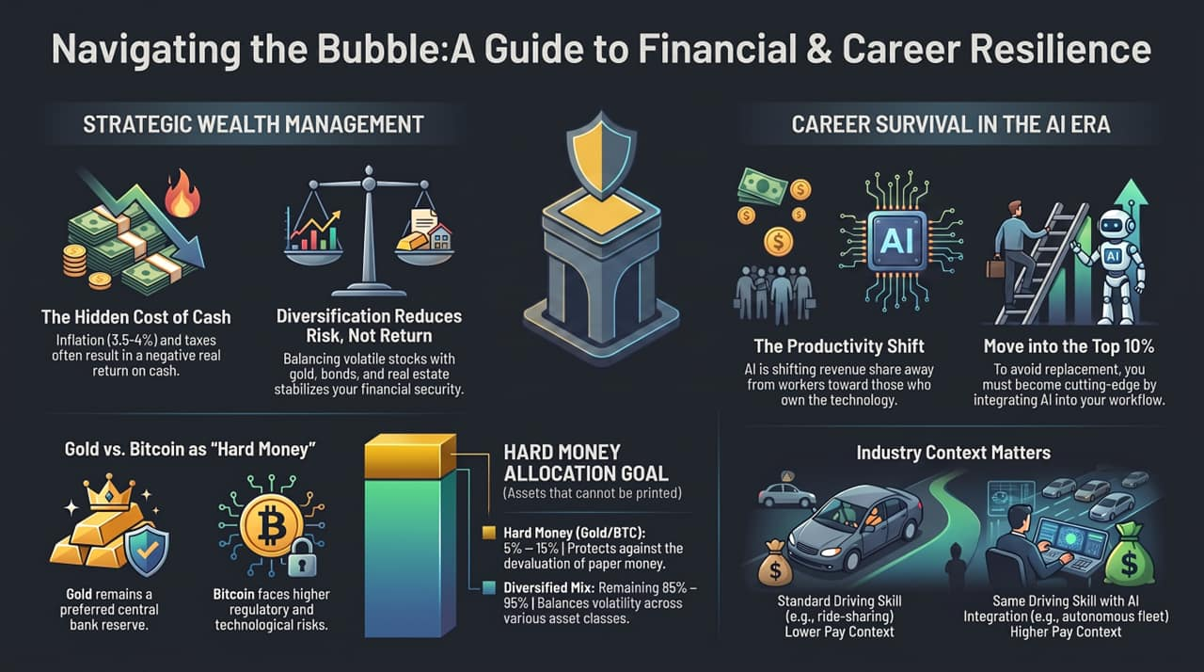
Notes:
Executive Wrap-up: To conclude today’s presentation, let's review our core action items across both wealth management and career survival:
Financial Actions:
Eliminate Cash Illusion: Recognize that idle cash guarantees lost purchasing power due to real inflation and taxes.
Diversify Broadly: Allocate across stocks, bonds, real estate, and hard assets to lower risk without cutting target returns.
Secure Hard Money: Hold 5–15% in unprintable assets—favoring gold for long-term central bank alignment, privacy, and systemic safety.
Career Actions:
Cross the Capital Divide: Realize that productivity gains are accruing to technology owners; seek equity and leverage.
Aim for the Top 10%: Leverage AI capabilities to achieve exponential output premiums over average labor market benchmarks.
Reposition Skill Context: Place your skills in high-value industries where your output commands premium compensation.

